Slide 1


AI Generated Draft
Data Visualization: Unlocking Insights
Apr 01, 2026

Slide 2
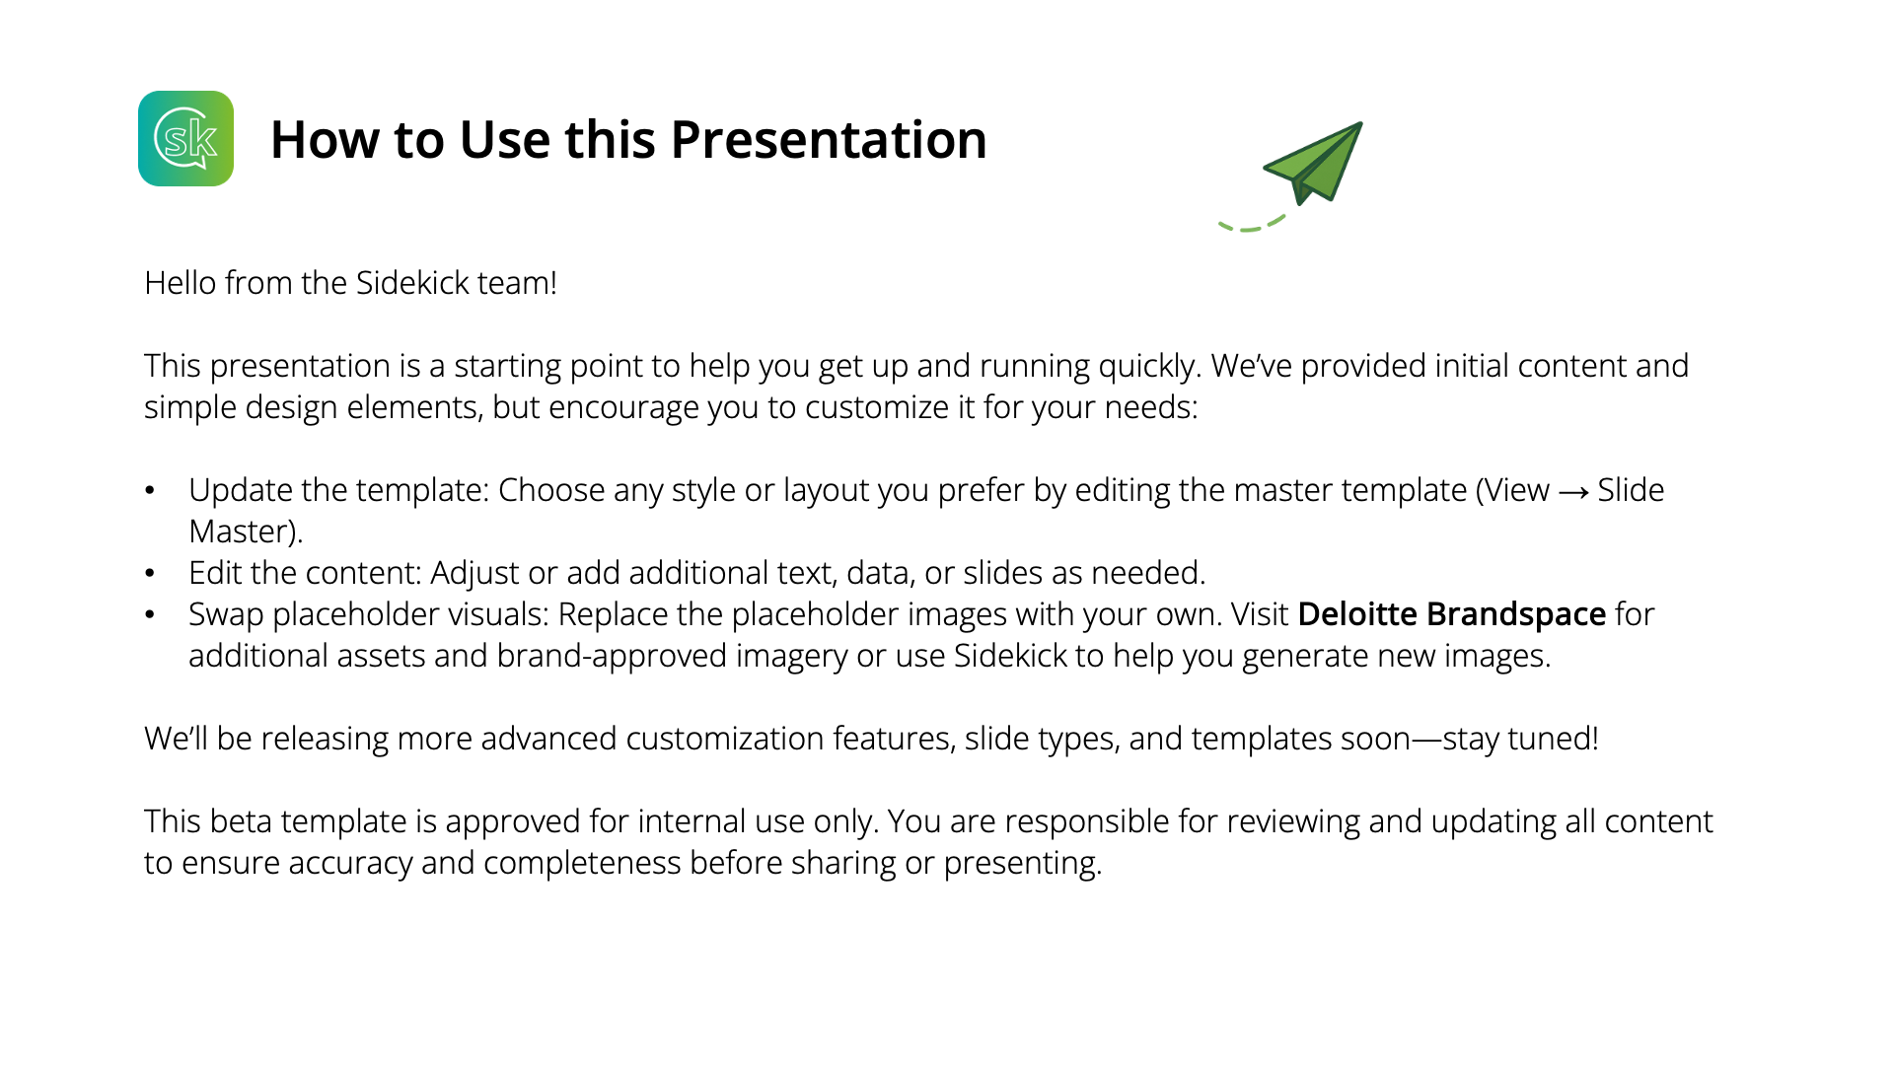
AI Generated Draft

Slide 3
Introduction to Data Set
Key Principles of data set
way of implementing the data set
Real-World Applications
business improvement and implementation
consideration
AI Generated Draft
Table of Contents

Slide 4
1. Introduction to Data Set
AI Generated Draft

Slide 5
AI Generated Draft
Data Visualization Overview
Transforming Numbers into Visual Stories
Data visualization translates raw information into visually meaningful formats such as charts, maps, and dashboards, enabling rapid understanding of trends, patterns, and outliers. It empowers analysts and decision-makers to explore, validate, and communicate complex data findings efficiently. As a core component of business intelligence and data science, data visualization plays a pivotal role throughout the analytical process—from initial exploration to presenting actionable results. Organizations rely on data visualizations to identify key performance drivers, monitor real-time metrics, and uncover relationships within large datasets. Modern platforms often integrate AI to enhance predictive capabilities and interactive dashboards, facilitating informed decisions across teams. Typical,

Slide 6
AI Generated Draft
Importance & Use Cases
Driving Business Performance
Communication
Decision Making
Business Impact
Data visualization is fundamental to modern analytics and data science. It bridges communication gaps between technical and non-technical stakeholders, presenting insights with clarity. Visualization tools enable rapid exploration, comparison, and sharing, making data accessible and actionable for diverse audiences.
Visualizations are key in uncovering patterns that drive strategic improvements. By mapping sales, customer engagement, or KPIs, companies can make more proactive adjustments and optimize outcomes based on evidence, rather than intuition. Visual evidence accelerates decision-making and encourages collaboration within project teams.
Data visualization simplifies complex datasets, making it easier to grasp insights and make decisions quickly. Businesses utilize visualization tools for tracking performance and understanding trends in real time, which is crucial for operational agility. Interactive graphics allow users to explore data and find connections that might be overlooked in raw tables.

Slide 7
2. Key Principles of data set
AI Generated Draft

Slide 8
AI Generated Draft
Foundation for Insightful Visuals
Principles for Effective Visualization
Clarity
Accuracy
Storytelling
Best Practices
Clear visuals eliminate clutter, ensuring the main message stands out. Labels, legends, and color schemes are carefully chosen so the audience can immediately understand what matters. Simplicity enables quick, intuitive data interpretation.
Accurate visualizations faithfully represent the underlying data. Designers avoid misleading scale choices, truncated axes, or excessive effects that can distort insights. Consistency in style and proportion maintains trust and integrity.
Effective visualizations guide viewers through a narrative journey. By connecting visuals with text and highlighting key points, storytelling bridges the gap between analytics and human understanding, leading to actionable decisions.
Following established principles—such as using intuitive metaphors, minimizing gridlines, and selecting suitable chart types—helps avoid confusion and maximizes the impact of data. Ethical guidelines ensure responsible communication.

Slide 9
AI Generated Draft
KEY INSIGHT
Good Visualization Drives Understanding

Slide 10
3. way of implementing the data set
AI Generated Draft

Slide 11
AI Generated Draft
Chart Selection & Usage
Choosing Visualization Types for Data
Heatmaps
Scatter Plots
Line Graphs
Bar Charts
Heatmaps use color intensity to represent value, useful for geographic distributions or identifying clusters within big datasets. Advanced dashboards combine these charts for holistic, interactive monitoring and decision support.
Scatter plots show relationships between two variables, exposing correlations, outliers, or distributions. Used extensively in scientific research and business analytics, scatterplots turn high-volume data points into visual patterns.
Line graphs excel at displaying continuous data over time, such as KPIs, trends, or historical changes. Grouped lines allow comparisons between series, revealing cycles or anomalies, and forecasting future outcomes easily.
Bar charts provide clear comparison across categories, making them ideal for sales targets, market share, or performance rankings. Their proportional design quickly conveys differences and trends, supporting rapid analysis.
Selecting the right type of visualization is critical: each chart or dashboard reveals different data relationships and supports unique goals.

Slide 12
AI Generated Draft
Advanced Visualization Methods
Core Visualization Platforms & Tools
Pie Charts
Maps
Dashboards
Pie charts are best for showing proportions of the whole. However, they become hard to read with many sections; use them only when categories are few and differences are clear, such as budget allocation or survey results.
Maps visualize data distribution across territories, essential for spotting geographic trends in marketing, public health, or resource allocation. They support regional analysis and spatial comparisons in real time or historical contexts.
Dashboards integrate tables, visual graphics, and KPIs into a cohesive, interactive platform. They support ongoing business monitoring, making trends, comparisons, and performance metrics visible at a glance for informed actions.
Visualizations must be tailored to the dataset and purpose—combining multiple chart types in dashboards optimizes clarity and decision-making.

Slide 13
4. Real-World Applications
AI Generated Draft

Slide 14
AI Generated Draft
Visualization in Practice
Visualizations uncover hidden insights, making data actionable for business leaders, researchers, and journalists across sectors.
Business
Science
Journalism
Visualize sales performance with dashboards
Track customer engagement and retention
Assess marketing ROI using comparative charts
Monitor disease outbreaks in healthcare
Analyze stock market trends in finance
Conduct climate change studies
Communicate complex data to the public
Present policy impacts accessibly
Highlight trends through infographics

Slide 15
AI Generated Draft
Cross-Sector Use Cases
Leveraging Data Visualization
How does journalism inform?
Across industries, visualizations turn raw numbers into stories, helping users discover patterns and communicate insights clearly to decision-makers or the public. They bridge knowledge gaps and foster engagement with both technical and non-technical audiences. Effective visualizations catalyze real-world action.
Makes complex data accessible
Drives impactful storytelling
Journalism
What is the role in science?
Enhances credibility in scientific research
Enables effective communication of results
Business
Science
How does business utilize?
Integrates live analytics in dashboards
Supports exploration of big data

Slide 16
5. business improvement and implementation
AI Generated Draft

Slide 17
AI Generated Draft
SWOT Analysis of Visualization
A clear-eyed view of visualization strengths and risks supports responsible, impactful business adoption.
Visual evidence speeds up decision-making processes.
Accessible dashboards keep teams aligned in real time.
Data quality can limit insight value.
Visuals sometimes lack accessibility for all users.
Growing demand for ethical, transparent data storytelling.
Advances in AI improve visual analytics capability.
Misleading visuals risk misinterpretation.
Bias or poor labeling may distort findings.

Slide 18
AI Generated Draft
Mitigating Risks, Maximizing Value
Applying ethical guidelines and accessible design principles ensures visualization empowers all users without bias or confusion.
Challenges
Best Practices
Inconsistent data leads to misleading trends.
Complex visuals confuse non-technical users.
Accessibility gaps hinder inclusivity.
Ethical issues risk distorting reality.
Use clear labels and concise legends.
Present uncertainty transparently.
Ensure accessibility for all audiences.
Select visual scales responsibly.

Slide 19
6. consideration
AI Generated Draft

Slide 20
AI Generated Draft
Accessibility & Transparency
Context & Storytelling
Final Recommendations & Takeaways
Test visualizations for accessibility, using screen-reader-friendly formats and color palettes that support all users. Be transparent about limitations or confidence intervals in the data.
Discuss findings in context and connect visuals to actionable outcomes, enabling non-experts to understand and make informed decisions. Storytelling enhances engagement and fosters cross-team buy-in.
Clarity & Simplicity
Data Quality First
Minimize design clutter and select colors with care for immediate, intuitive interpretation. Use legends and labels that anyone can understand and always document assumptions or uncertainty.
Always verify data quality before visualization to avoid misleading results. Tailor chart types to the data and audience; streamline complexity for clarity. Consider accessibility and ethical concerns

Slide 21
AI Generated Draft
References
What Is Data Visualization and Why Is It Important? | Definition From TechTarget: [Link]
Different Types of Data Visualizations – Critical Data Literacy: [Link]
What Are the Ethical Considerations of Data Visualization? → Question - Climate → Sustainability Directory: [Link]
What Is Data Visualization? Benefits, Types & Best Practices: [Link]
Using the Right Visualizations - The Definitive Guide to Dashboard Design - insightsoftware: [Link]
Principles of Effective Data Visualization: From Purpose to Proof | AFFiNE: [Link]
5 Data Visualization Principles - Visvero: [Link]
What is Data Visualization? Examples, Importance, & More - ThoughtSpot: [Link]
Data Visualisation: Definition, Benefits, and Examples - Coursera: [Link]
Real Life Data Visualization Examples - GeeksforGeeks: [Link]

Slide 22
AI Generated Draft
Disclaimer: Output quality is your responsibility and top priority. Outputs generated by Sidekick may contain information that is inaccurate, dated, incomplete, or not aligned to your specific needs. You are responsible for ensuring the accuracy, completeness, and relevance of any output generated by Sidekick and how such output is used internally. You must thoroughly review all content and source materials for accuracy and edit such output as necessary before sharing internally. Outputs generated by Sidekick must not be considered final deliverables.

